Slide 1

Guraz Buhariwala
Rico Holganza
Ramana Killi
Varuna Paul Jeeva
Megha Sharma

Slide 2

Business opportunity
Industry
According to Travel Goods Association, U.S backpack sales were $ 3.7 Billion in 2017
Over the next five years, industry revenue is expected to continue to rise (3.9% annually)
Backpacks are the number one choice of consumers to carry all of their gear, eating into sales of computer cases, business cases and handbags
Evolving Customer Needs
Customers care about quality, comfort, style
'Always on the run lifestyle’
Professionals are increasingly using backpacks rather than briefcases
Women are switching from purses to backpacks
Students’ everyday carry needs are shifting

Slide 3
DESIGN THINKING PROCESS
Abstract
Frameworks
Imperatives
Observations
Solutions
Analysis
Synthesis
Concrete

Slide 4
Frameworks
Imperatives
Observations
Solutions

Slide 5
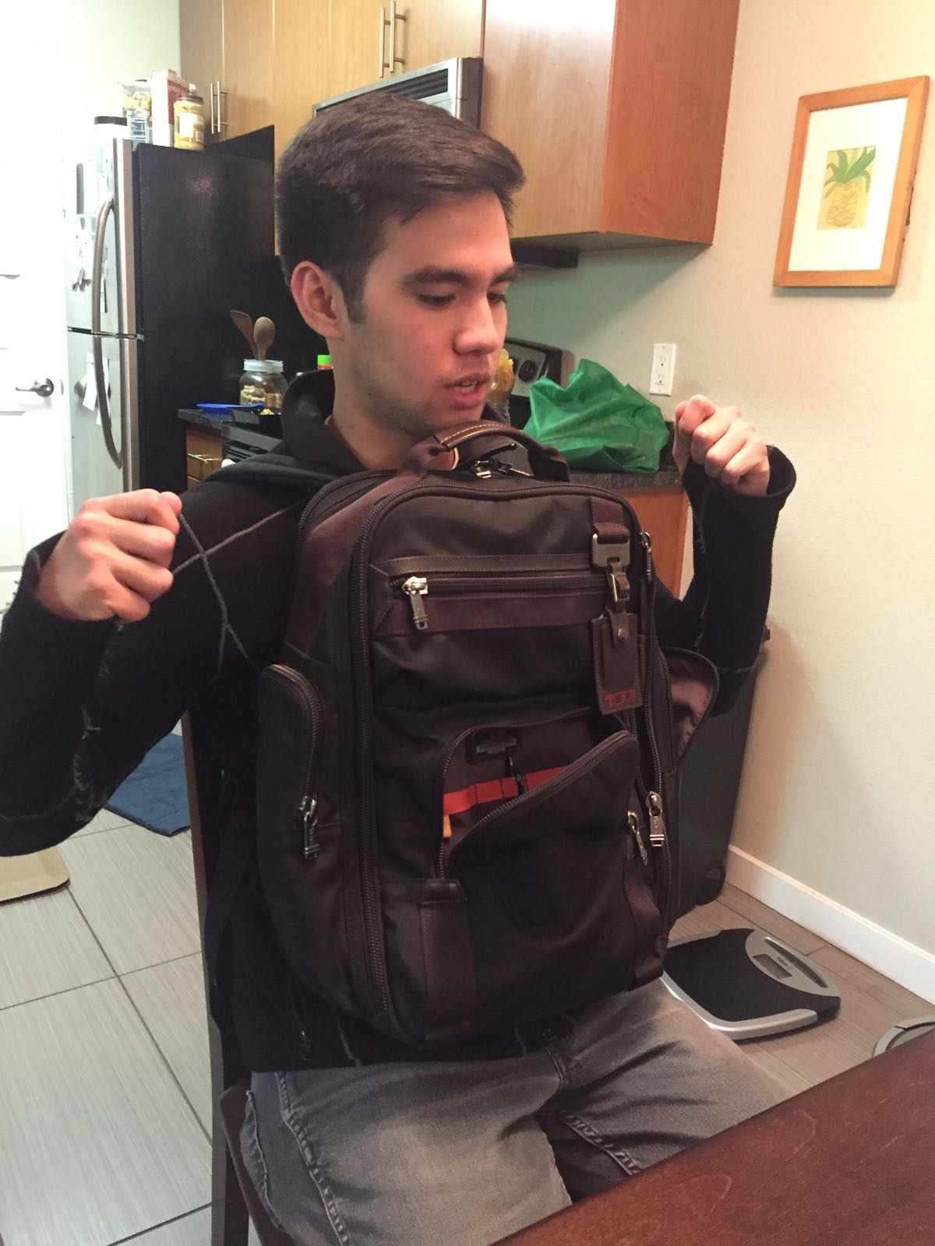
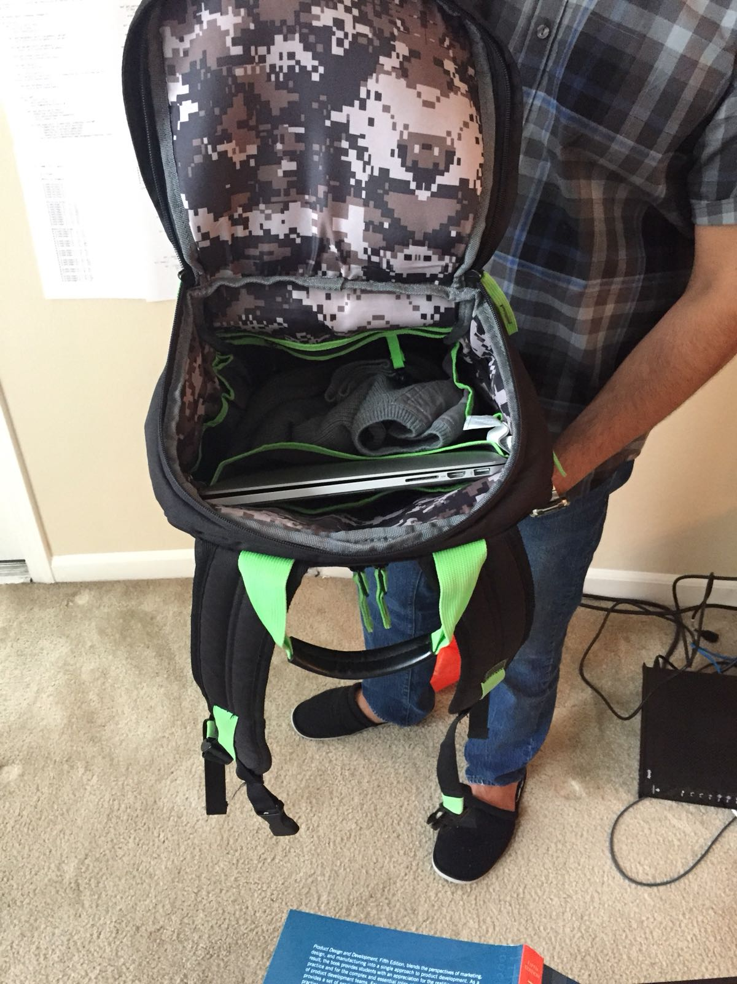
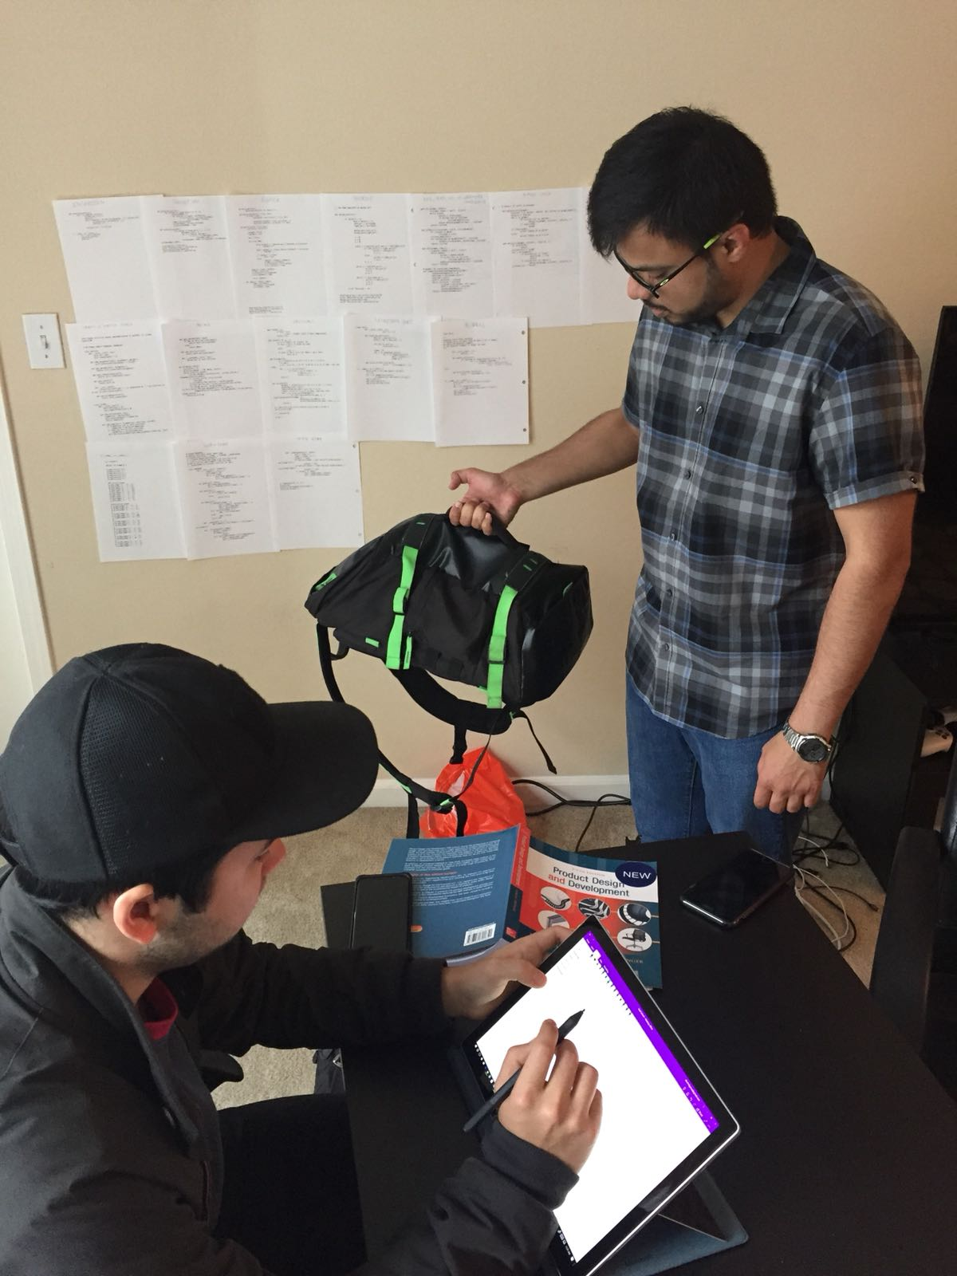
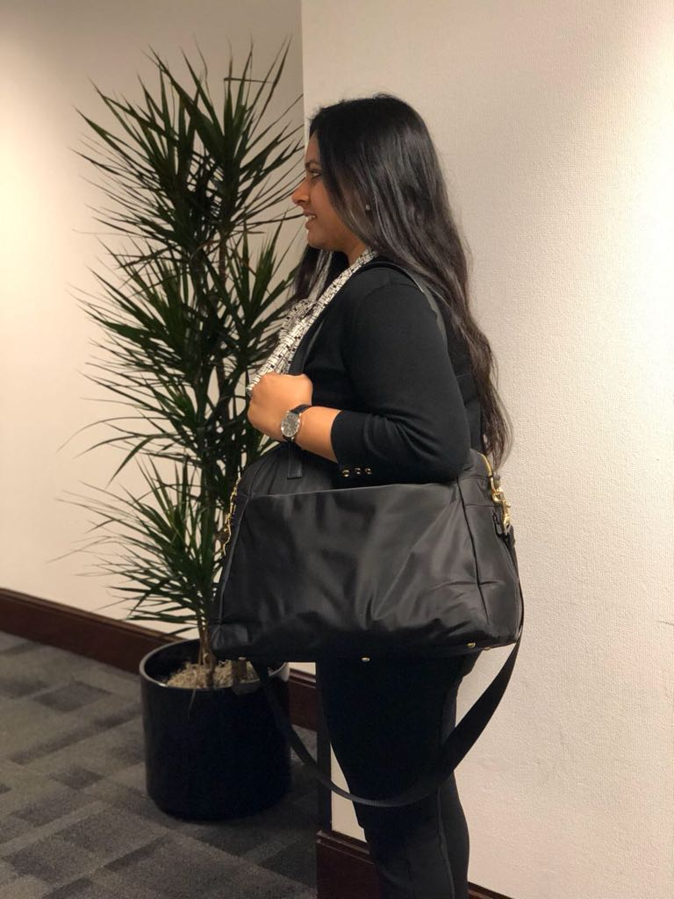
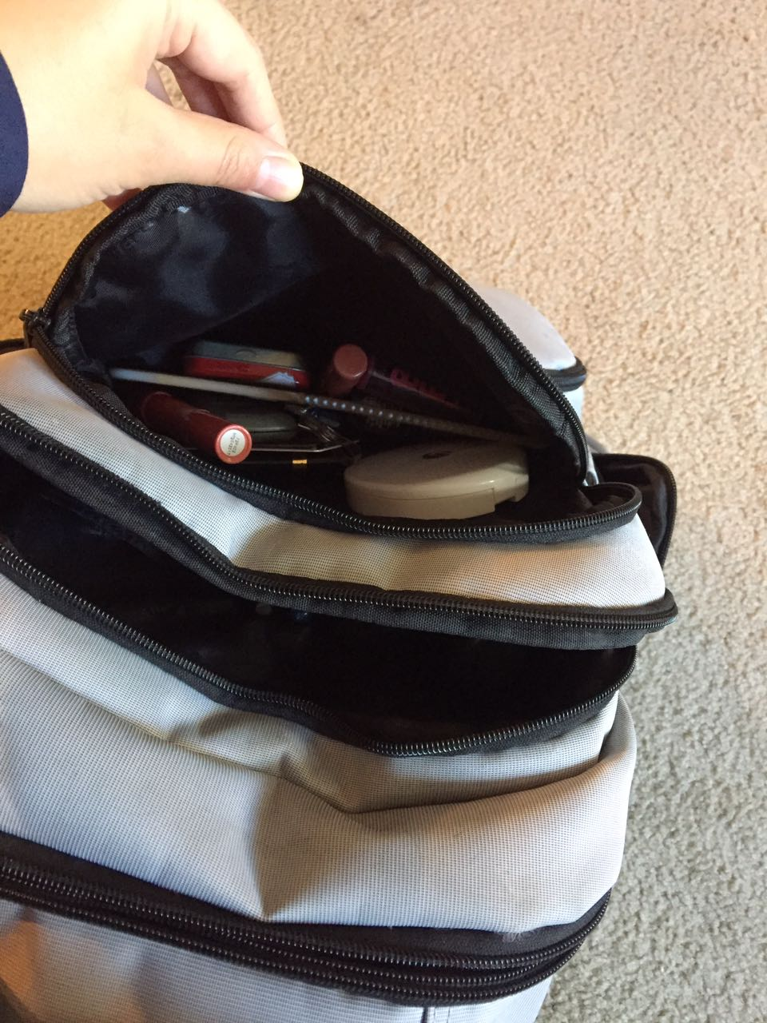
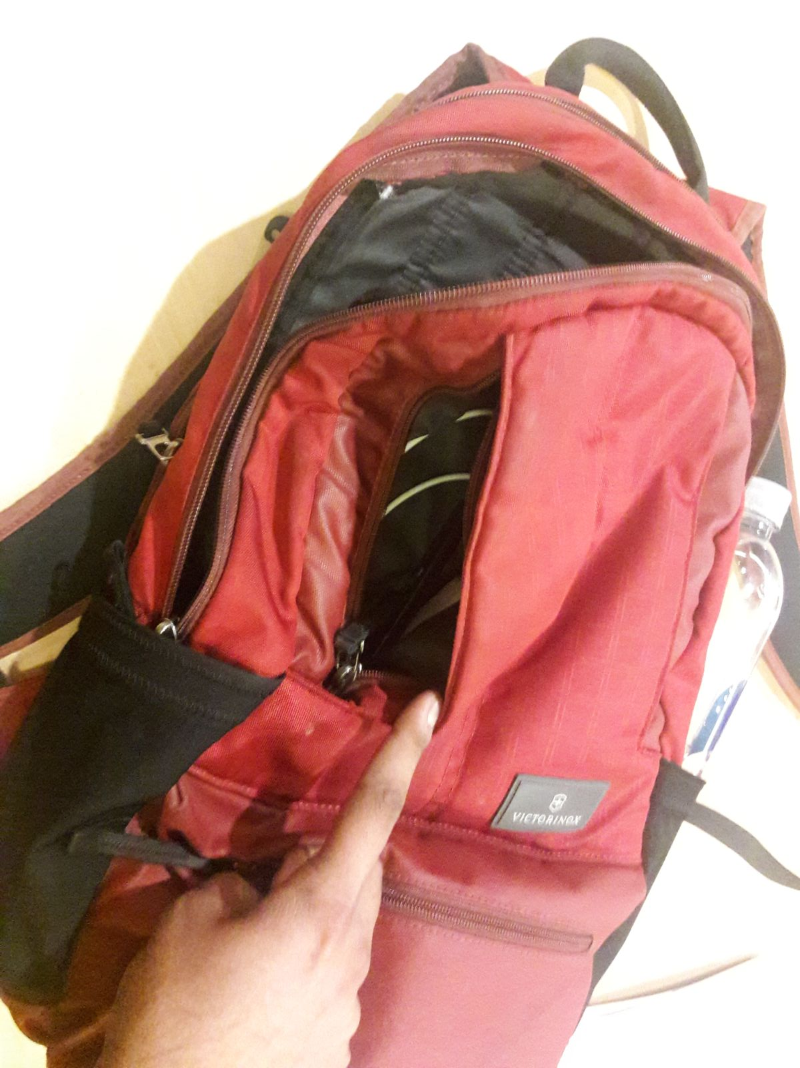
User interviews

Slide 6
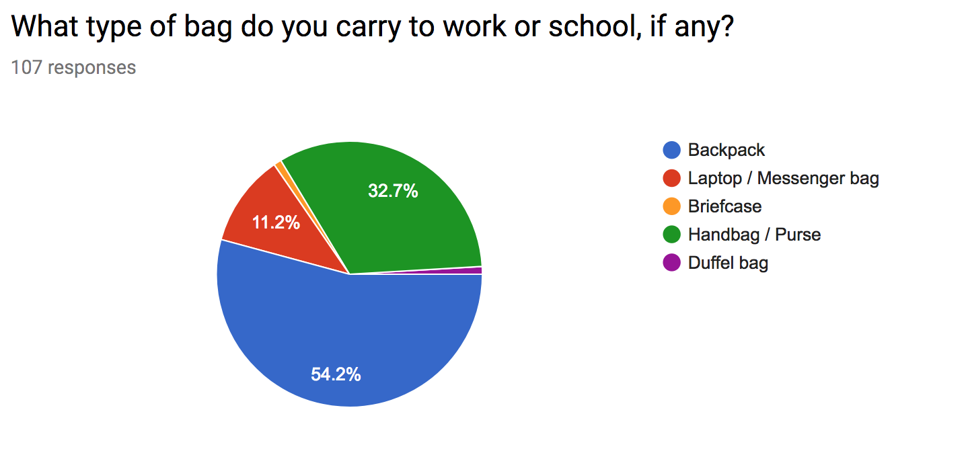
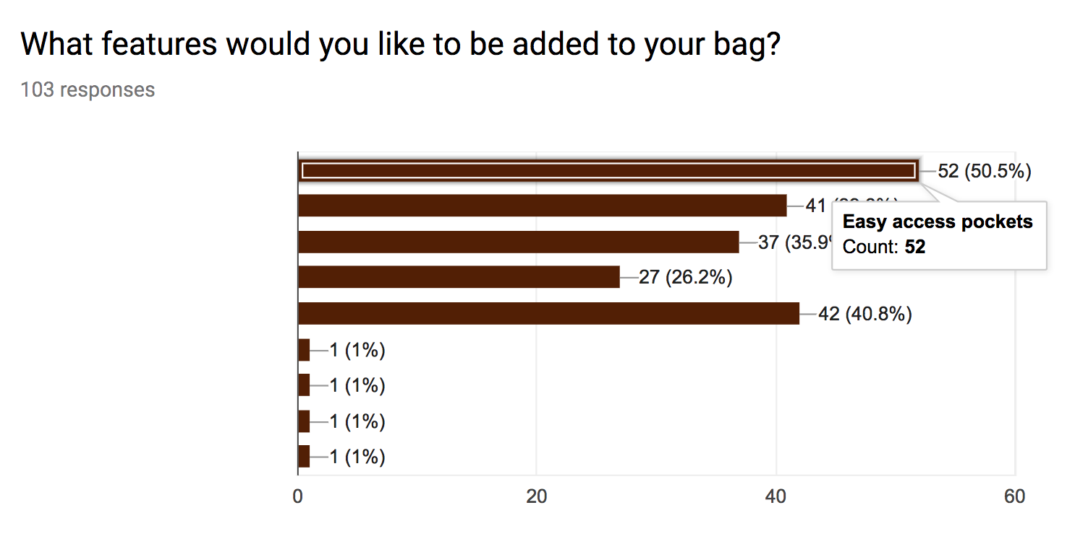
survey
Notes:
Talk about the top 5 features

Slide 7
Frameworks
Imperatives
Observations
Solutions

Slide 8
Frameworks
Imperatives
Observations
Solutions

Slide 9
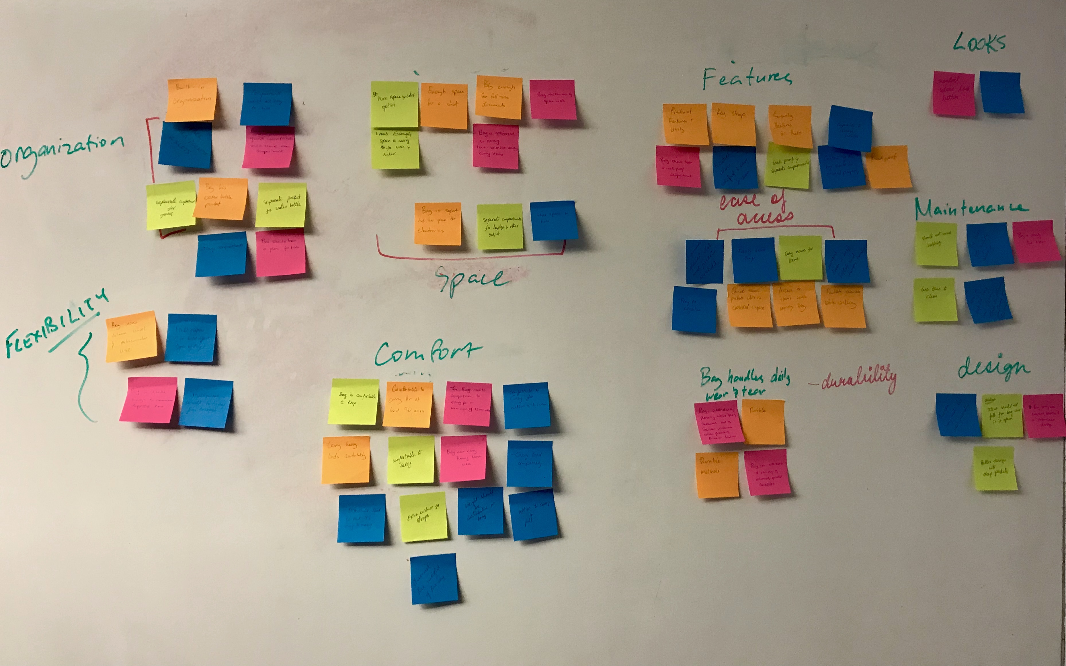
clustering

Slide 10
Important User needs
Bag should have many organizational options
Contents of the bag must be easily accessible
Bag is flexible enough for different use cases
Bag must be comfortable to carry
Bag handles daily wear and tear and is easy to maintain
Bag has to look good, is not bulky and has a decent design
Bag must have some key features such as being waterproof / leakproof, able to secure the contents safely, etc.

Slide 11
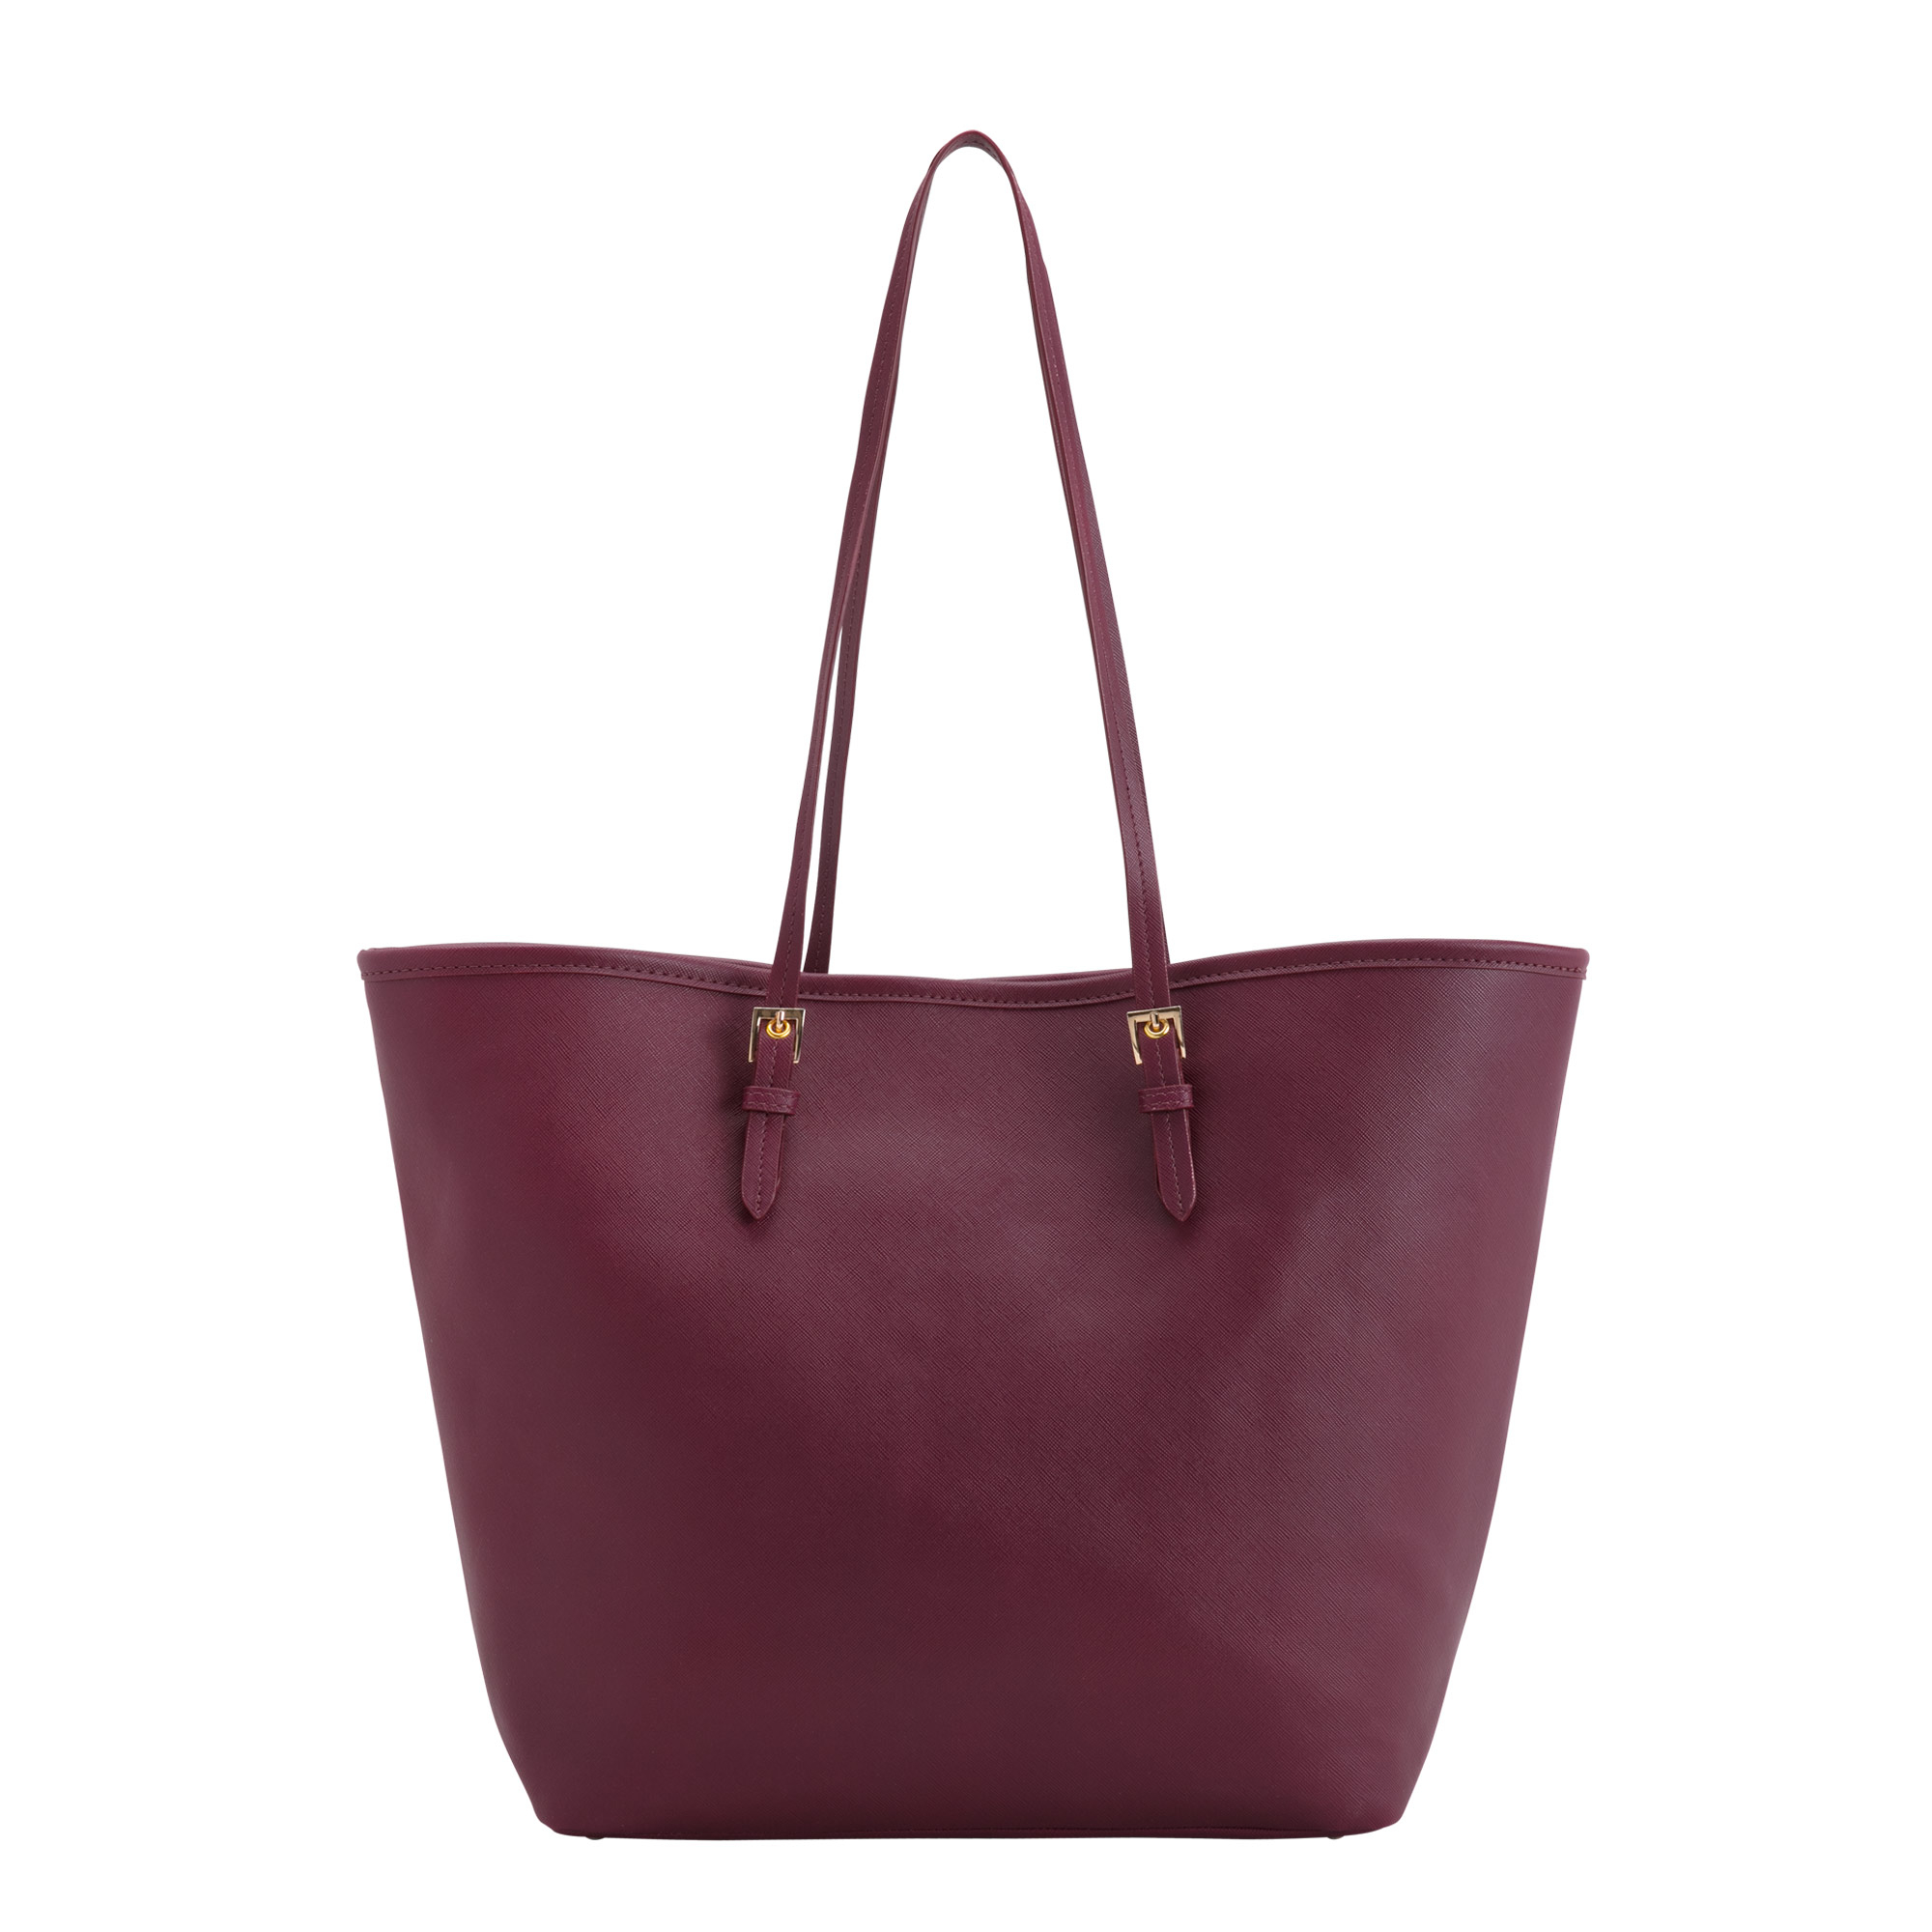
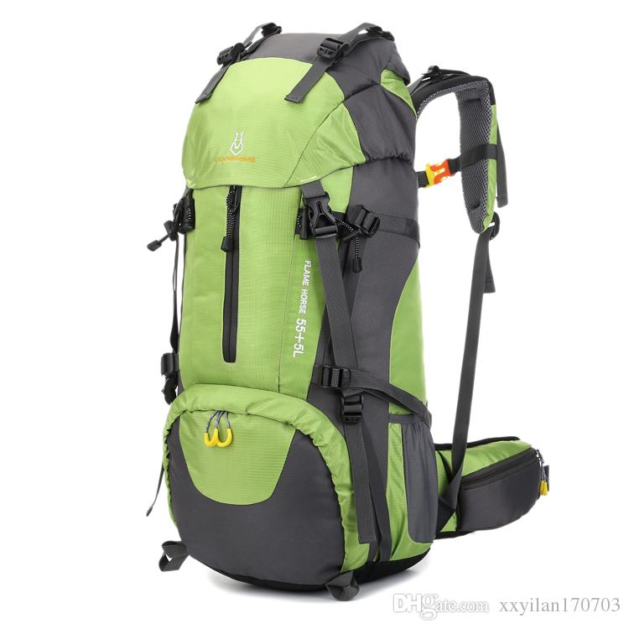
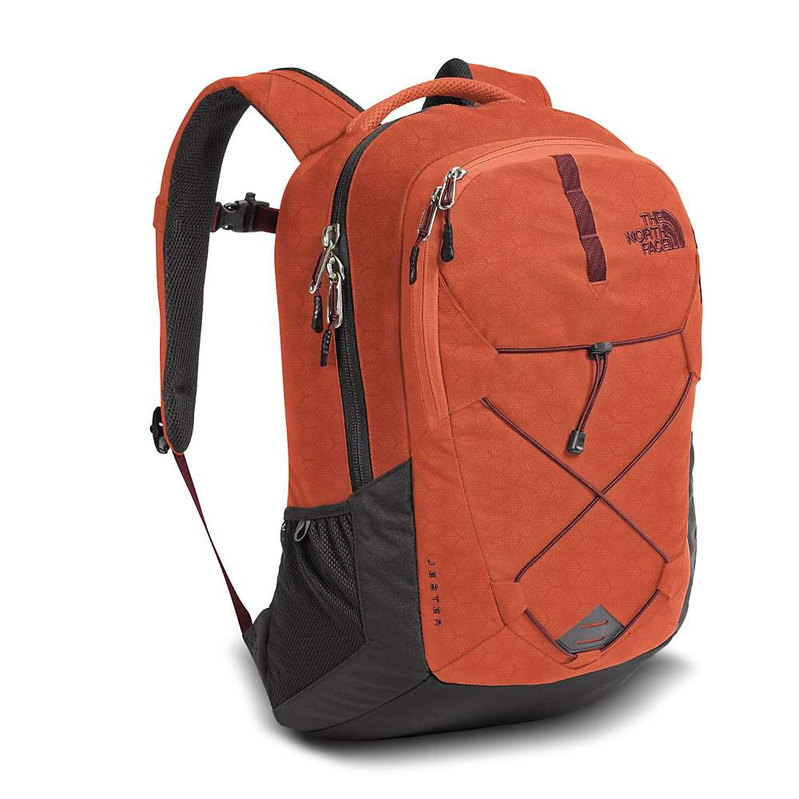
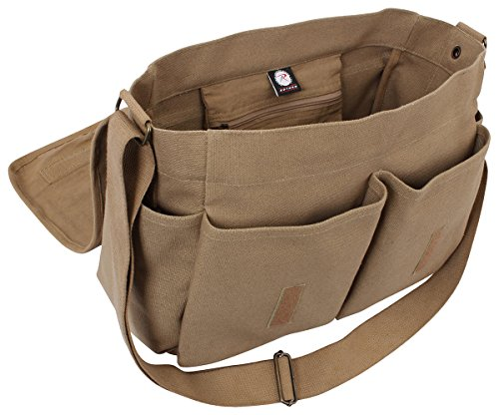
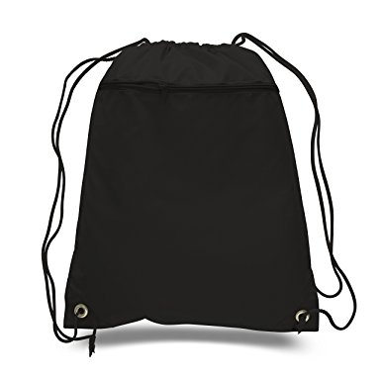
2 x 2 matrix
Easy to access contents on the go
Difficult to access contents on the go
More expensive
Less expensive
Tote bag
Outdoor gear
Backpack
Messenger bag
Drawstring bag

Slide 12
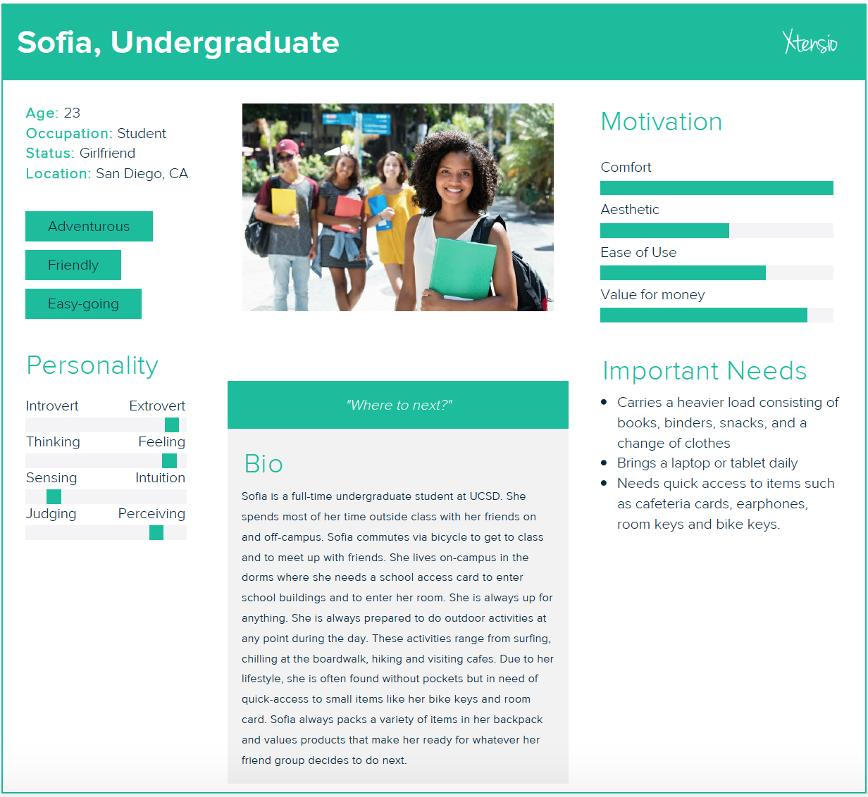
personas

Slide 13
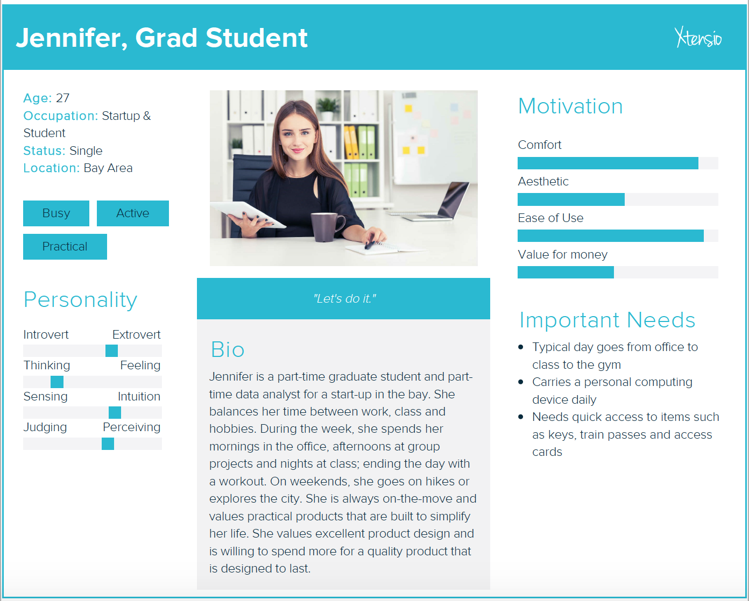
personas

Slide 14
market opportunity
TAM
Total World Population 7.62 Billion
People in the age group of 7 to 60 5 Billion
% People who would be interested in the product 10%
Average amount a customer would be willing to pay for the solution $10
Total Addressable Market $5 Billion
SAM
Total U.S. Population 326 Million
People in the age group of 7 to 60 238 Million
% People who would be interested 35%
Average amount a customer would be willing to pay for the solution $15
Served Addressable Market $1.25 Billion
TARGET MARKET
People falling in the age group between 18 to 28 30 Million
% People who would be interested 50%
Average amount a customer would be willing to pay for the solution $15
Target Market $225 Million

Slide 15
Frameworks
Imperatives
Observations
Solutions

Slide 16
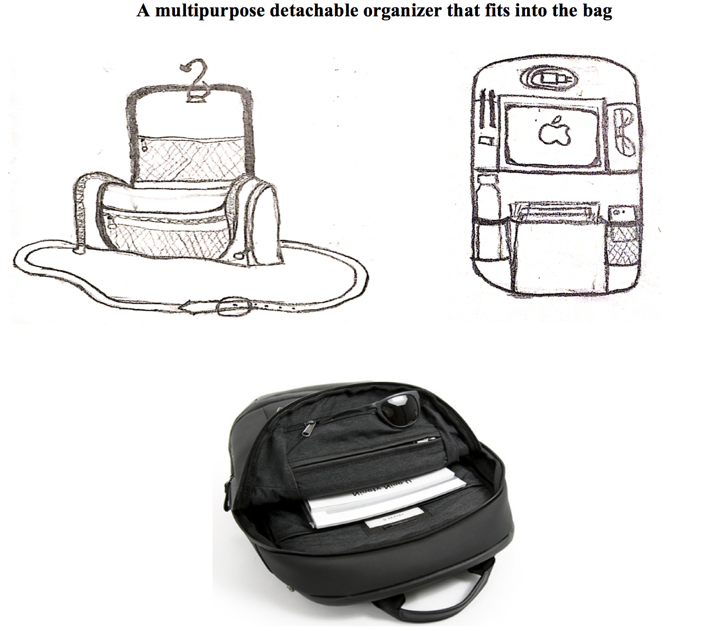
CONCEPT A

Slide 17
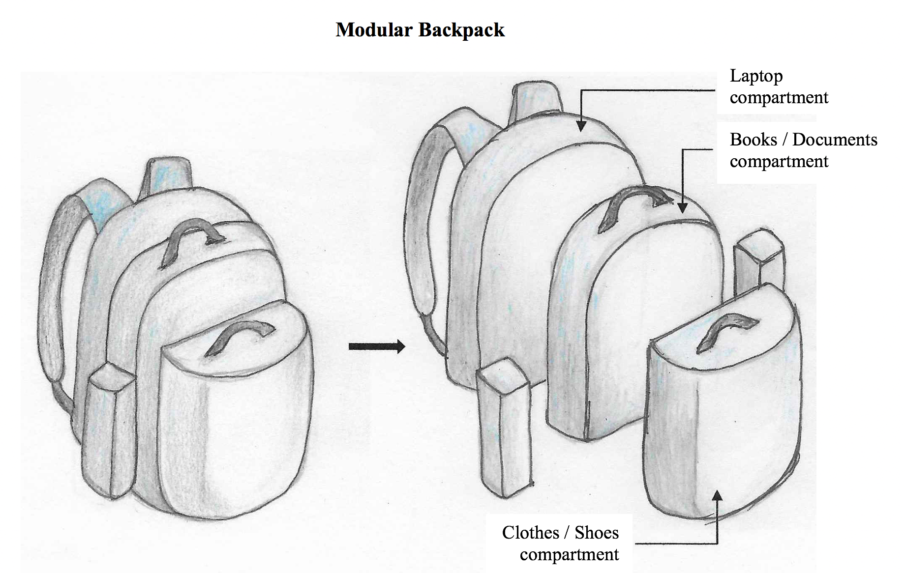
CONCEPT B

Slide 18
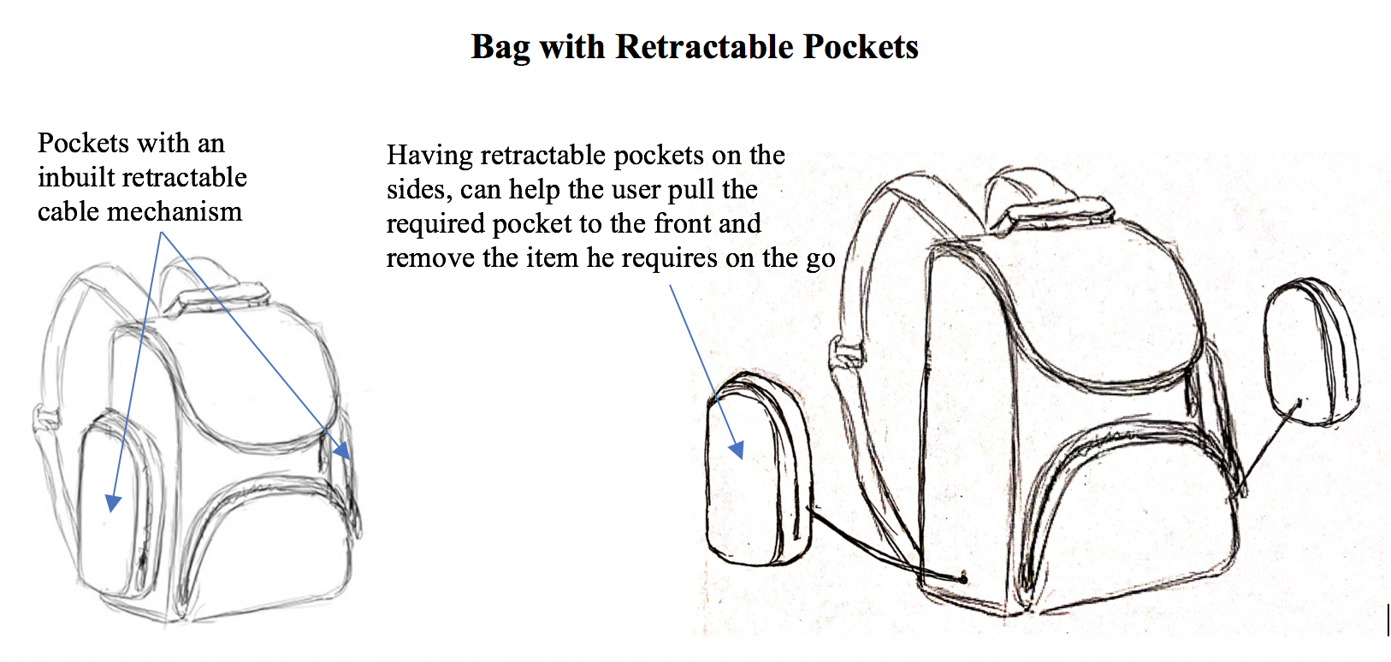
CONCEPT C

Slide 19
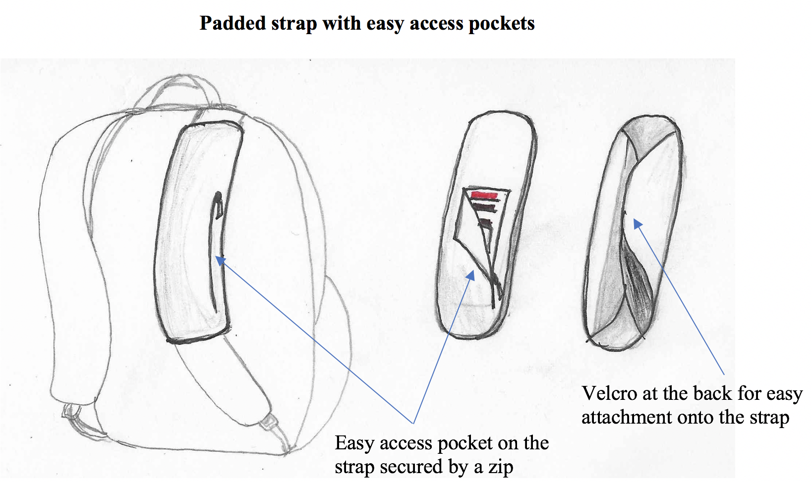
CONCEPT E

Slide 20
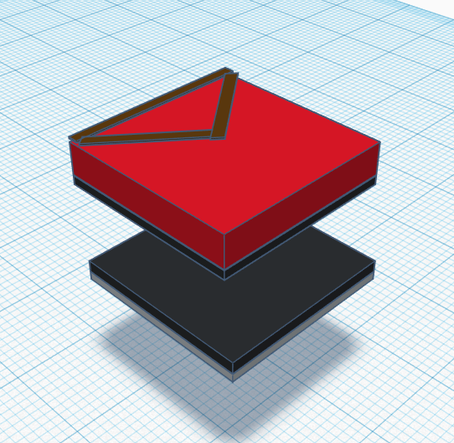
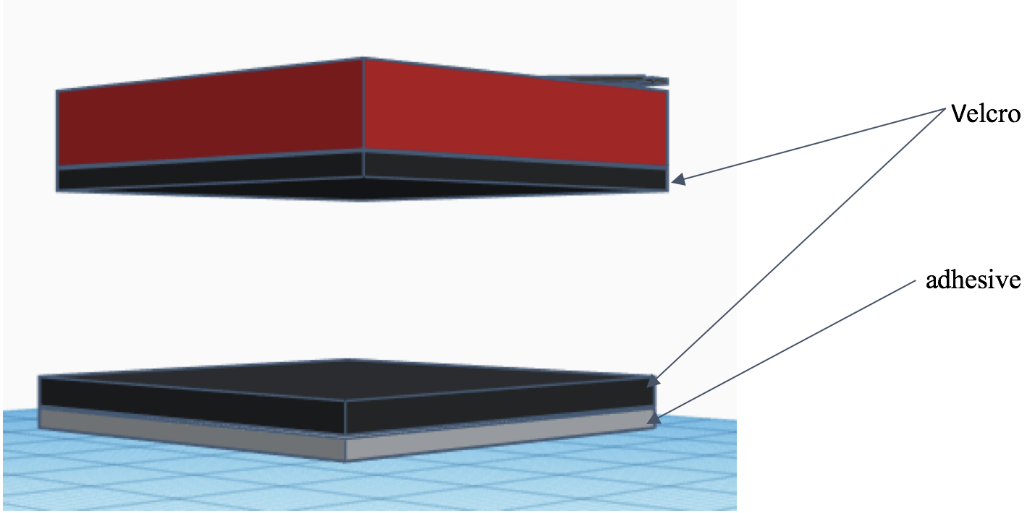
CONCEPT F

Slide 21
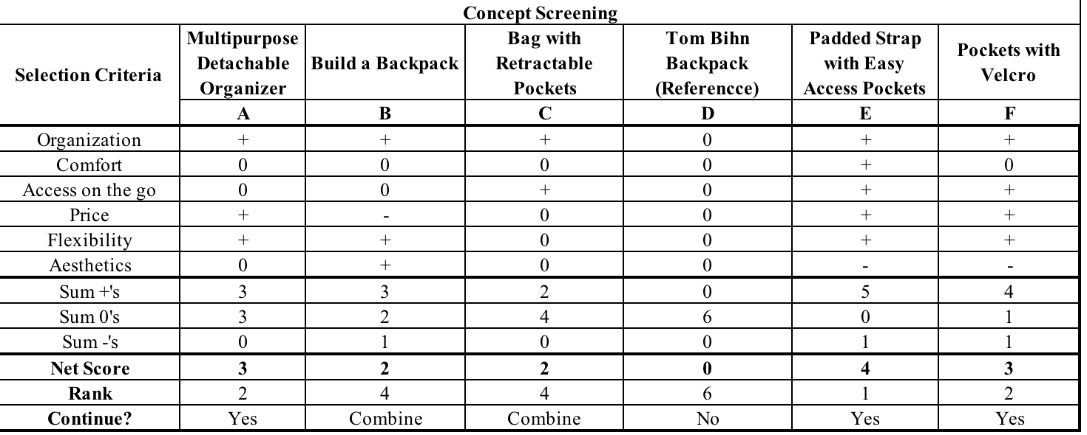
CONCEPT SCREENING

Slide 22
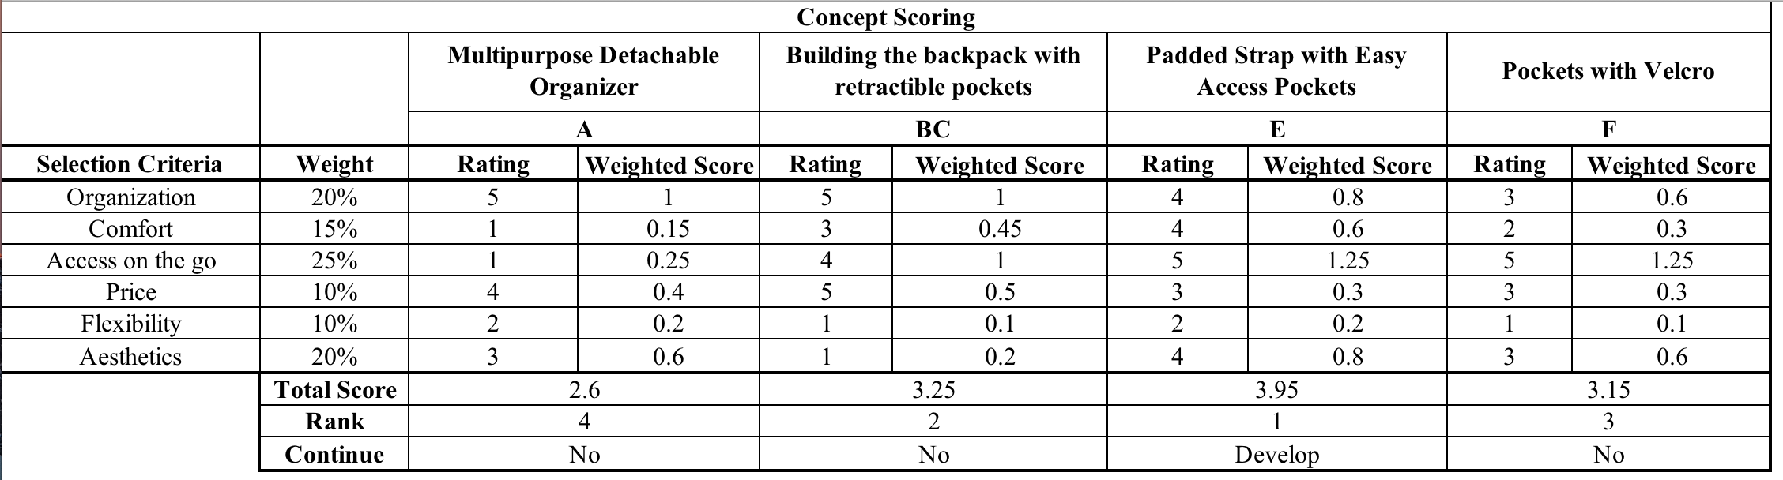
CONCEPT SCORING

Slide 23
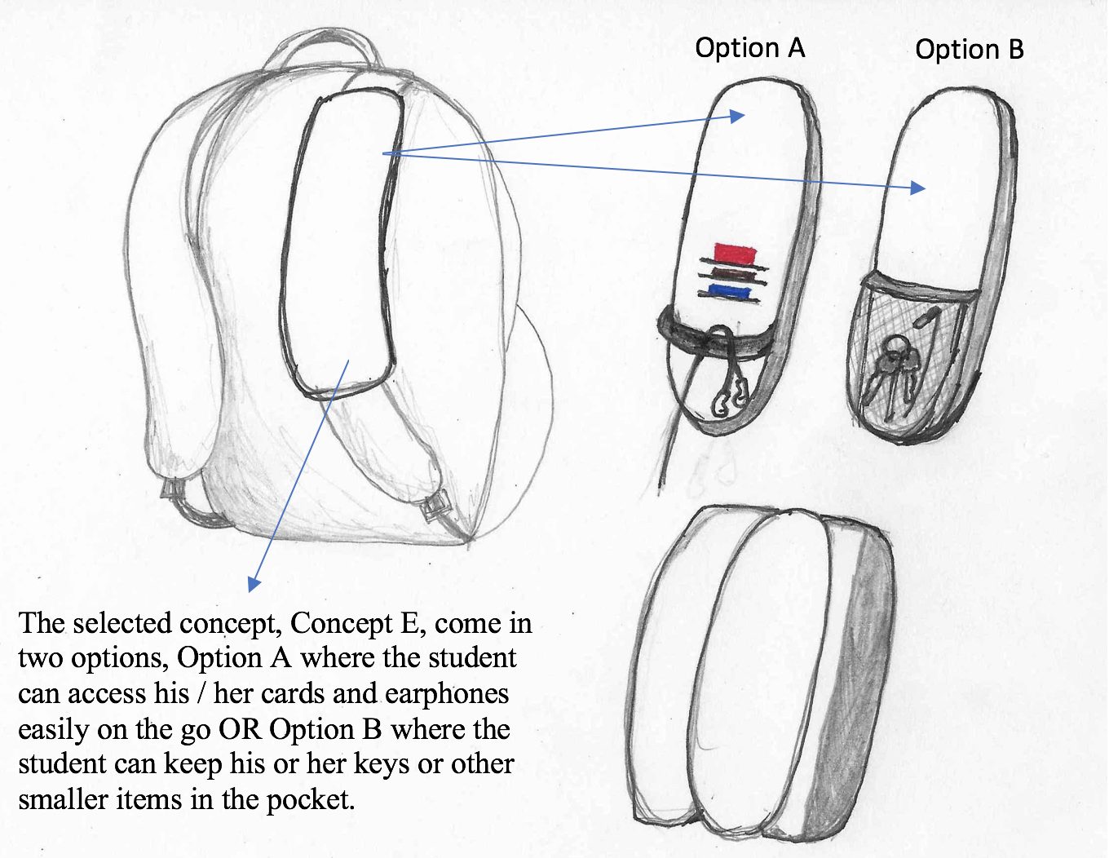
SELECTED CONCEPT

Slide 24
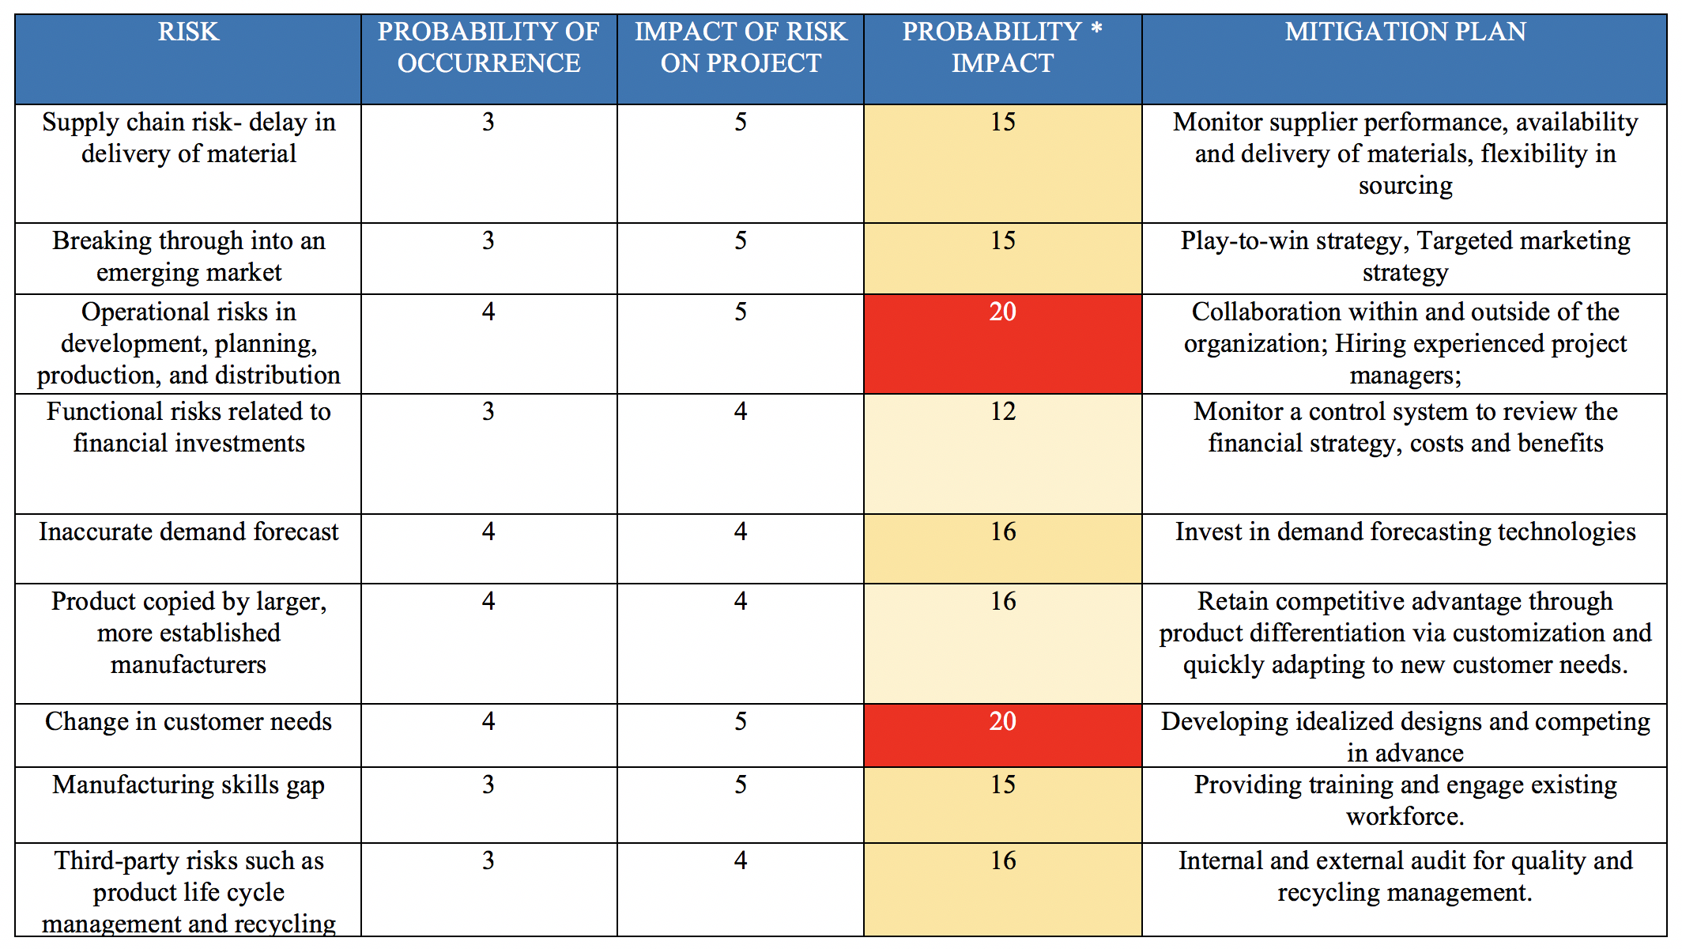
RISK ASSESSMENT

Slide 25
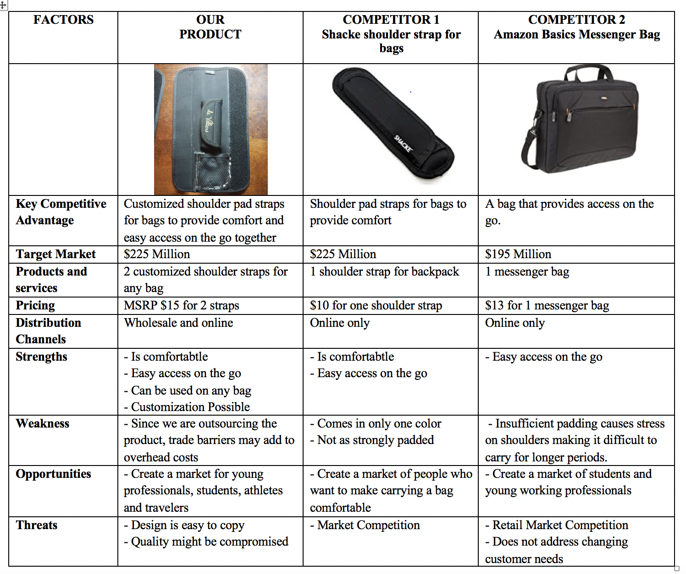
COMPETITIVE ASSESSMENT

Slide 26
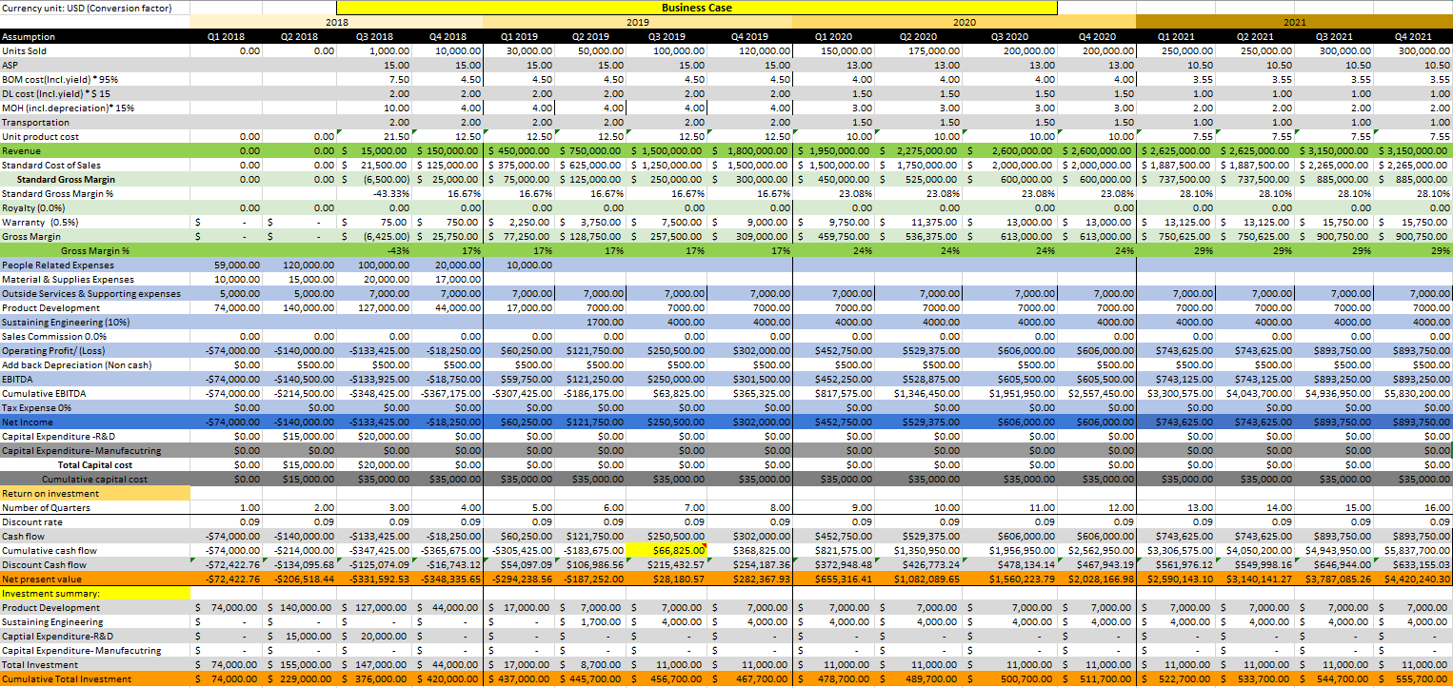
Business case

Slide 27
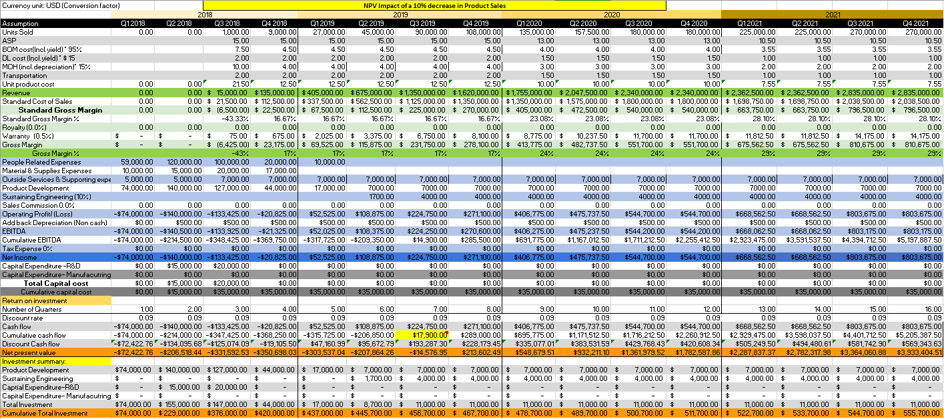
10% decrease – Product sales

Slide 28
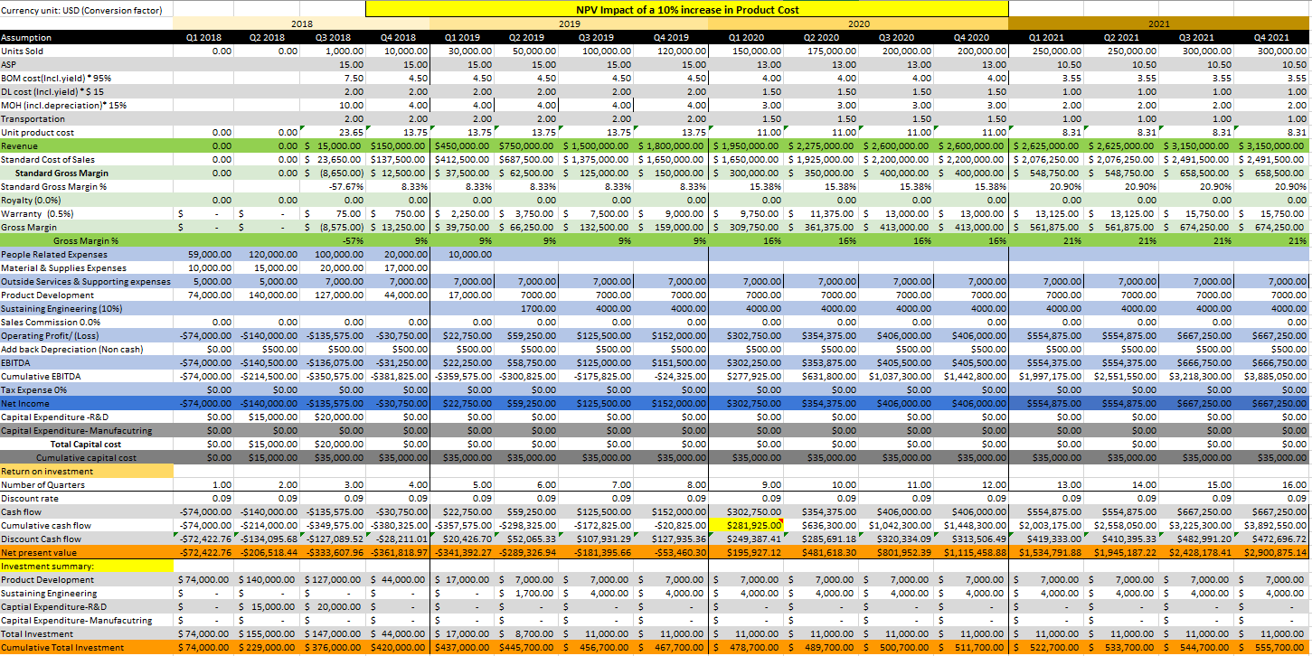
10% increase – Product cost

Slide 30
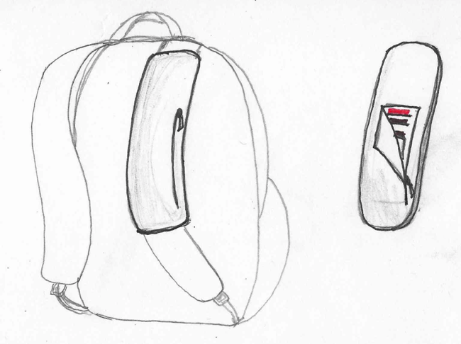
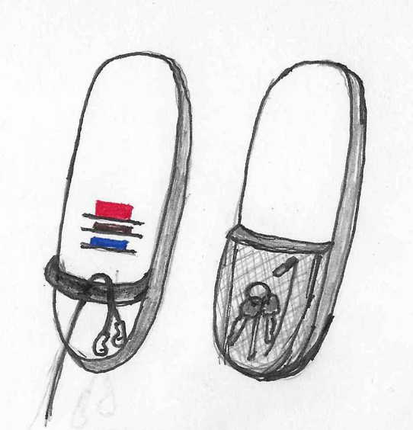
PROOF OF CONCEPT

Slide 31
THANK YOU! WE ARE NOW ACCEPTING SEED CAPITAL…..

